Slide 1

PRACTICAL EXAM
PRODUCT SALES

Slide 2

Business Goal
The company has launched a new product line six weeks ago and has collected the data of three different sales strategies. The executive team want to update on what was the performance of each sales approach in order to choose the best one for continuously using in the future.
The insights that the sales representatives want to know:
What is the best sale method for the new product line ?
Are there any other differences between the customers in each method?

Slide 3

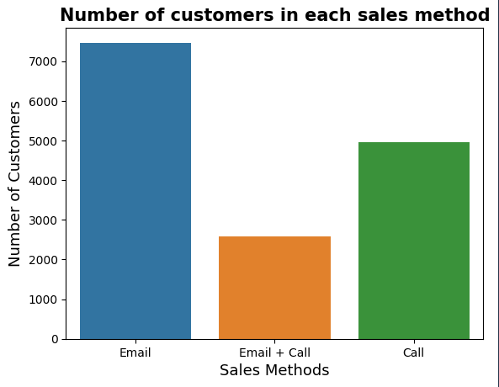
Exploratory Analysis Outcome:
The number of customers for each approach:
During the last 6 weeks of the launch of new product line, number of customers in ‘Email’ method is the highest, followed by ‘Call’ and almost tripled the number of that in ‘Email + Call’ method.

Slide 4
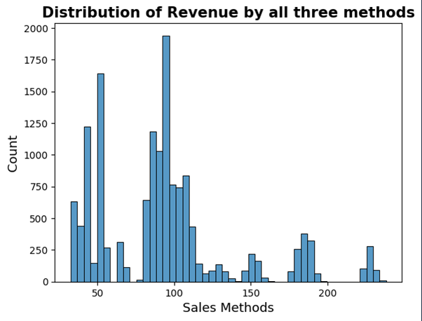
Exploratory Analysis Outcome:
The spread of revenue overall:
From the graph, we can see that the distribution of all-method revenue is mostly ranged from 30 to below 200, especially from 30 to about 120.
Those are over 200 can be considered as outliers

Slide 5
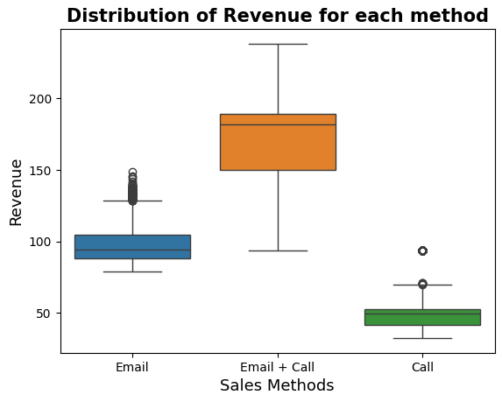
Exploratory Analysis Outcome:
The spread of revenue overall for each method:
Based on both the previous and this graph, we can say that the majority of revenue coming from ‘Email’, ‘Call’ and a small number of ‘Email + Call’ method.

Slide 6
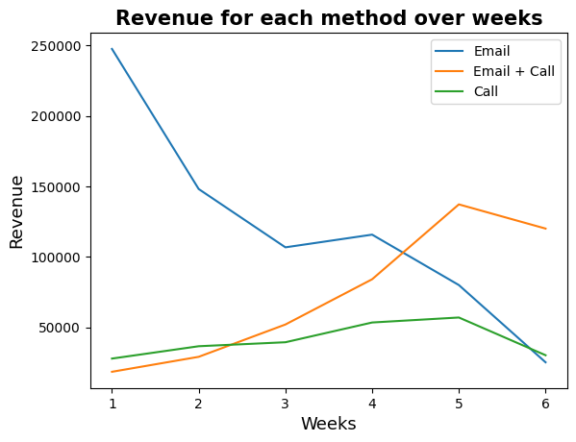
Exploratory Analysis Outcome:
Difference in revenue over time for each of the methods:
The given chart showed that the total revenue in ‘Email’ significantly decreased from 250.000 to below 30.000.
While that in ‘Email + Call’ witnessed an opposite trend of increase from 20.000 to about 120.000.
And the ‘Call’ method showed a fluctuation but is not considerable during the 6-week period.
At the sixth week, the total revenue of ‘Email + Call’ is dramatically higher than other methods.

Slide 7
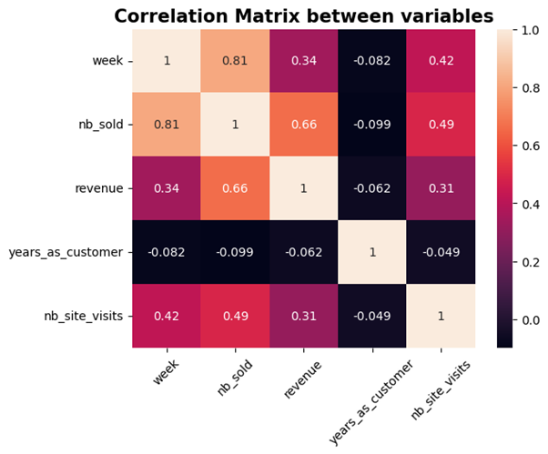
Exploratory Analysis Outcome:
The factor to consider to increase sales:
The correltion coefficient between number of sold products and revenue with the number of website visits were moderately positive at 0.49 and 0.31 respectively,
It means that the more website visits company gained, the more sold products and revenue were.

Slide 8

Business metrics:
As our goal is to find the best sale method for the sale representatives, I would recommend to use The percentage of total revenue of ‘Email + Call’ methods over weeks to track its progress in the future.
The total of revenue of 'Email + Call' method occupied approximately 31% in the last 6 weeks since the launch of new products. If this number continues increasing, it indicates a really good sign of the best sale method for the team.

Slide 9

Recommendation:
In the future, I would recommend these following steps:
Using the recommended metrics to track progress of ‘Email + Call’ method in the future
Considering not to carry out the 'Call' method as although it has been applied to many customers, it was really time-consuming and low-efficient in creating revenue for the company.
Continuing using the 'Email' method if possible as:
It requires very little works for the team and a significant revenue also coming from this method.
We can consider to combine this method into the ‘Email + Call’ method.
Continuing using the 'Email + Call' method because:
It requires a little work for the sale representatives, the value of its orders was really high and had an impressive increase in revenue since the first week.
It has advantages of both the 'Email' and 'Call’ method so we need consider to combine all into this method.

